Slide 1
Advance Java
Lecture 1

Slide 2
Agenda
Introduction to Web Applications
Introduction to servlet
Servlet vs. CGI
Servlet Life cycle
Servlet API overview
Generic servlet
HTTP Servlet
Servlet Config
Servlet Context

Slide 3
Introduction to Web Applications
A Web application is a server-side application that contains Web components(servlets and JSP pages), HTML/XML documents, and other resources in a directory structure or archived format, known as a Web Archive(WAR) file.
A Web application is generally located at a central server, which provides services to various clients.
In a Web server, the Web components can be conveniently distributed as Java Archive(JAR) files with .war extension.
Web applications are of the following two types:
Presentation-oriented – generates dynamic content and web pages by using various markup languages, such as HTML and XML. A presentation-oriented application generally serves as a client for the service-oriented web applications.
Service-oriented – Implements a web service and is invoked by presentation-oriented web applications.

Slide 4
Describing Components of a Web Application
A web application consists of web components such as Java Servlet and JSPs.
An application based on the MVC paradigm contains three components, Model, View, and Controller.
A view is created by using JSP and the logic to manage requests is implemented in servlets, which serve as Controller.
Moreover, the existing business rules in an application are referred to as Model.

Slide 5
Introduction to Servlet
A Java Servlet is used to extend the capabilities of servers in a client-server programming model and is considered the building block for developing web applications.
Servlets can respond to any type of requests.
Servlets are executed on the web servers.
Servlets are portable platforms that are used to provide dynamic content, irrespective of the web server in use.
A browser-based application that calls a servlet does not need support for Java, as the output can be of any other type, such as HTML or XML.
Servlets are based on Java, this feature allows servlets to function on any platform that has a Java Virtual Machine(JVM) and a web server that supports servlets.

Slide 6
Introduction to Servlet
If we make any change in the code of a servlet, it is necessary to recompile and redeploy that servlet so that the change is reflected in the application.
Servlets can communicate directly with existing enterprise resources by using generic APIs, such as JDBC.

Slide 7
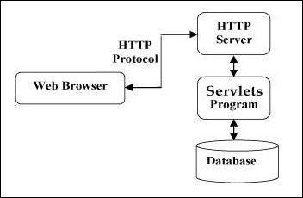
Servlets

Slide 8
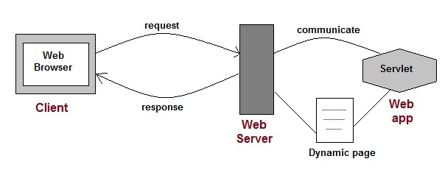

Slide 9
Servlets
Servlets perform the following major tasks −
Read the explicit data sent by the clients (browsers). This includes an HTML form on a Web page or it could also come from an applet or a custom HTTP client program.
Read the implicit HTTP request data sent by the clients (browsers). This includes cookies, media types and compression schemes the browser understands, and so forth.
Process the data and generate the results. This process may require talking to a database, executing an RMI or CORBA call, invoking a Web service, or computing the response directly.
Send the explicit data (i.e., the document) to the clients (browsers). This document can be sent in a variety of formats, including text (HTML or XML), binary (GIF images), Excel, etc.
Send the implicit HTTP response to the clients (browsers). This includes telling the browsers or other clients what type of document is being returned (e.g., HTML), setting cookies and caching parameters, and other such tasks.

Slide 10
Common Gateway Interface(CGI)
The Common Gateway Interface (CGI) is the first technology used to generate dynamic contents. It allows a web client to pass data to the application running on the web server so that a dynamic web page can be returned to the client according to the input data. For example, when you use a search engine, buy a book at an online store; get a stock quote etc., your browser uses CGI to communicate with a server side application.
CGI is not a programming language, rather it is an interface (or a set of rules) that allows an input from a web browser and produce an output in the form of HTML page. A CGI script can be written in a verity of languages such as C, C++, Visual Basic, Perl, FORTRAN and even Java. Out of these, Perl is most commonly used.
When a web server receives a request for a CGI script, the web server passes some parameters to this script and executes it. The script runs and generates some output which is then collected by the web server and returned to the client (browser).

Slide 11
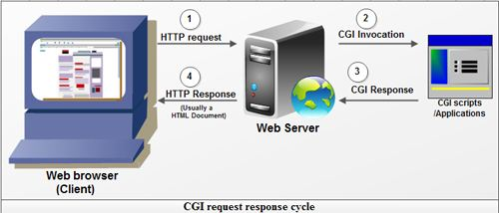
Common Gateway Interface(CGI)

Slide 12
<html>
<head><title>Cluster Analysis</title></head>
<body>
<form action="/cgi-bin/clusteranalysis.pl" method="GET">
How many clusters?
<input type=text name="clusters" size=3>
<input type=submit value=" OK ">
</form>
</body>
</html>

Slide 13
Servlet vs CGI
Both Java servlets and CGI are used for creating dynamic web applications that accept a user request, process it on the server side and return responses to the user. However, Java servlets provide a number of advantages over traditional CGI which are as follows,
Efficient: Unlike traditional CGI where a new process is started for each client request, a servlet processes each request as a thread inside of a process. Thus servlets improve the performance as it removes the overhead of creating a new process for request every time.
Also, unlike CGI program which terminates after handling a request, the servlets remains in memory even after they complete a response and destroyed only when the servlet container is shutdown. Thus servlets make it easier to cache computations, keep database connections open and perform other optimizations that rely on persistent data.

Slide 14
Servlet vs CGI
Powerful: Servlets support several capabilities that are difficult or impossible to accomplish with traditional CGI. These capabilities include talking directly to the web server, sharing data between multiple servlets, session tracking and caching of previous computations.
Portable: Since servlets are written in the Java programming language and follow a standard API, so a servlet can be moved from one servlet compatible web server to another very easily. For example, servlets written for Apache web server can run unchanged on other severs such as Microsoft Internet Information (IIS) Server, IBM Web Sphere etc. On the other hand, CGI programs may be platform dependent, need to be recompiled or web server dependent.
Inexpensive: A number of free or very inexpensive web servers are available these days. Once you have a web server, adding servlet support to it costs very little. On the other hand, CGI alternatives require a significant initial investment to purchase a proprietary package.

Slide 15
Servlet vs CGI
Language dependency: Since servlets can be written only in Java so they are language dependent. On the other hand, CGI programs can be written in any programming language like C, C++, Perl, Visual Basic or even Java so they are language independent.
Secure: As Java was designed from the ground up as a secure language, so a servlet can be run by a servlet engine or servlet container in restrictive sandbox just like an applet runs in a web browser's JVM, which increases the server security. On the other hand, CGI scripts are not subject to same degree of security sandboxing as Java servlets, they are significantly less secure.
Convenient: Servlets have an extensive infrastructure for automatically parsing and decoding HTML form data, reading and setting HTTP headers, handling cookies, session handling etc. On the other hand, CGI does not support such infrastructure.

Slide 16
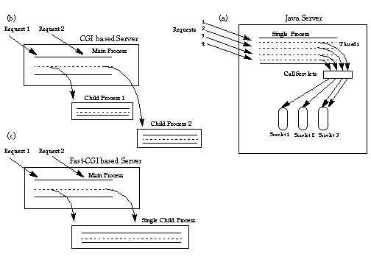

Slide 17
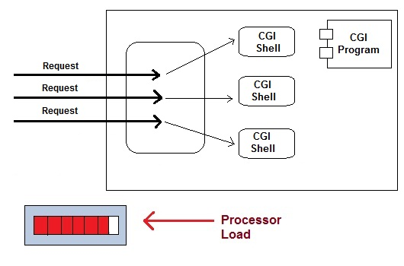

Slide 18
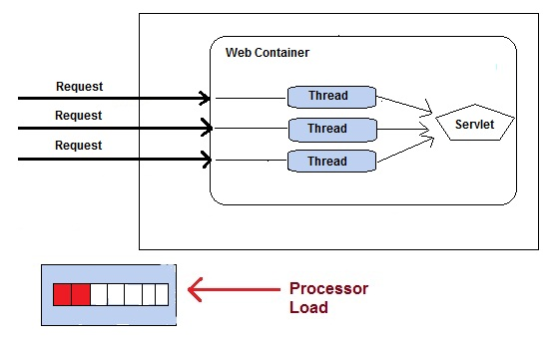

Slide 19
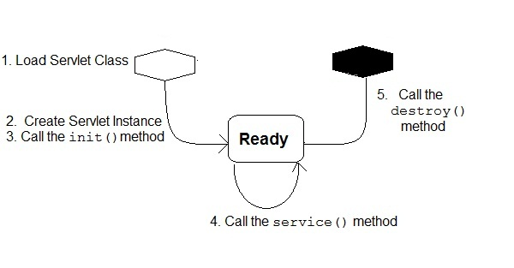
Servlet Lifecycle

Slide 20
Servlet Lifecycle
Loading Servlet Class : A Servlet class is loaded when first request for the servlet is received by the Web Container.
Servlet instance creation :After the Servlet class is loaded, Web Container creates the instance of it. Servlet instance is created only once in the life cycle.
Call to the init() method : init() method is called by the Web Container on servlet instance to initialize the servlet.Signature of init() method :
public void init(ServletConfig config) throws ServletException
Call to the service() method : The containers call the service() method each time the request for servlet is received. The service() method will then call the doGet() or doPost() methos based ont eh type of the HTTP request, as explained in previous lessons.Signature of service() method :
public void service(ServletRequest request, ServletResponse response) throws ServletException, IOException
Call to destroy() method: The Web Container call the destroy() method before removing servlet instance, giving it a chance for cleanup activity.

Slide 21
Servlet API Overview
There are standard base classes javax.servlet.GenericServlet and javax.servlet.http.HttpServlet that implement the servlet callback methods.
Servlet programming, then, consists of subclassing one of these classes and overriding the necessary method to accomplish the specific task at hand.

Slide 22
Servlet API Overview
javax.servlet
Servlet is a server-side web technology. As the name implies, it serves a client request and receives a response from the server. You have to implement javax.Servlet (Interface) to handle a servlet work.

Slide 23
Servlet Methods
void init() : Servlet container calls this method to specify that the Servlet has to be placed for service. In the whole life-cycle of Servlet the init() method is called only once. Syntax of init() method
public void init(ServletConfig config) throws ServletException
A Servlet can't be started by the following two reasons :
If, the init() method doesn't return within a specified time specified by the server
If, the init() method throws ServletException.
void service() : Once, the Servlet is started i.e. init() method is return within the specified server time and the init() method doesn't throws ServletException then a Servlet is ready to provide the services. The service method is based on the HTTP request and response. Service method handles the request and response using two objects javax.servlet.ServletRequest and javax.servlet.ServletResponse. Syntax of service() method
public void service(ServletRequest request, ServletResponse response) throws ServletException, IOException

Slide 24
Servlet Methods
void destroy() : Servlet container calls this method to specify that the Servlet has to be taken out of service. In the whole lif-cycle of the Servlet destroy() method is called only once. Syntax of destroy() method
public void destroy()
String getServletInfo() : This method is used to find out the information of a Servlet like, version, author etc. Syntax of getServletInfo()
public String getServletInfo()
ServletConfig getServletConfig() : This method is used to get the ServletConfig object. Syntax of getServletConfig()
public ServletConfig getServletConfig()

Slide 25
Generic Servlet
javax.servlet.GenericServlet
public abstract class GenericServlet extends java.lang.Object implements Servlet, ServletConfig, java.io.Serializable
GenericServlet defines a generic, protocol-independent servlet.
GenericServlet gives a blueprint and makes writing servlet easier.
GenericServlet provides simple versions of the life-cycle methods init and destroy and of the methods in the ServletConfig interface.
GenericServlet implements the log method, declared in the ServletContext interface.
To write a generic servlet, it is sufficient to override the abstract service() method.

Slide 26
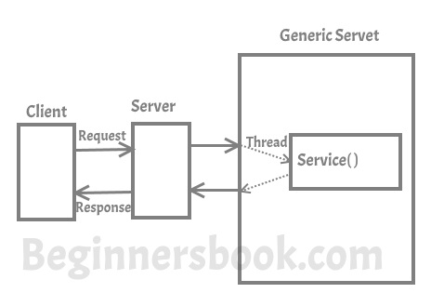

Slide 27
HttpServlet
javax.servlet.http.HttpServlet
public abstract class HttpServlet extends GenericServlet implements java.io.Serializable
HttpServlet defines a HTTP protocol specific servlet.
HttpServlet gives a blueprint for Http servlet and makes writing them easier.
HttpServlet extends the GenericServlet and hence inherits the properties GenericServlet.

Slide 28
HttpServlet
If you creating Http Servlet you must extend javax.servlet.http.HttpServlet class, which is an abstract class. Unlike Generic Servlet, the HTTP Servlet doesn’t override the service() method. Instead it overrides one or more of the following methods. It must override at least one method from the list below:
doGet() – This method is called by servlet service method to handle the HTTP GET request from client. The Get method is used for getting information from the server
doPost() – Used for posting information to the Server
doPut() – This method is similar to doPost method but unlike doPost method where we send information to the server, this method sends file to the server, this is similar to the FTP operation from client to server
doDelete() – allows a client to delete a document, webpage or information from the server
init() and destroy() – Used for managing resources that are held for the life of the servlet
getServletInfo() – Returns information about the servlet, such as author, version, and copyright.

Slide 29
HttpServlet
In Http Servlet there is no need to override the service() method as this method dispatches the Http Requests to the correct method handler, for example if it receives HTTP GET Request it dispatches the request to the doGet() method.

Slide 30
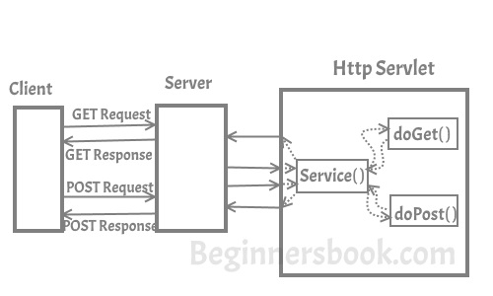

Slide 31
ServletConfig
When the Web Container initializes a servlet, it creates a ServletConfig object for the servlet. ServletConfig object is used to pass information to a servlet during initialization by getting configuration information from web.xml(Deployment Descriptor).
For every object of Servlet, the container creates, also an object of ServletConfig. This ServletConfig object is used to communicate with the Servlet under execution. Eventhough, the contianer creates the ServletConfig object implicitly for its purpose, the Programmer can make use of the object in his code to read initialization parameters into the Servlet from web.xml file.

Slide 32
ServletConfig
ServletConfig is an interface from javax.servlet package.
The getServletConfig() method of GenericServlet returns an object of ServletConfig.
The ServletConfig object created by the Web container for a specific Servlet cannot read other servlet’s init-param data.
ServletConfig object is specific for a Servlet. Other way to say, if 100 servlet objects are being executed in the container, 100 ServletConfig objects are also created implicitly used by the container to communicate with the Servlet.
When the container destroys the Servlet object, along with it its corresponding ServletConfig object also destroyed.
Programmer can make use ServletConfig object to read tags of the Servlet.

Slide 33
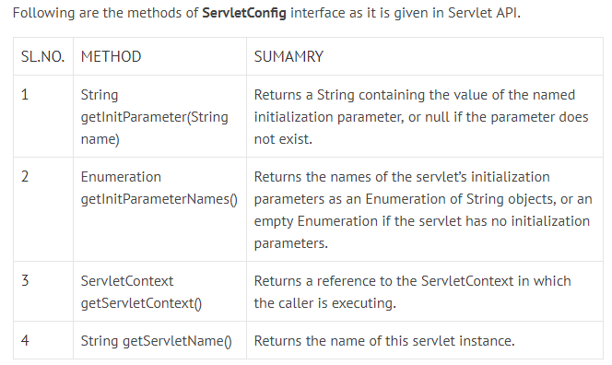

Slide 34
web.xml
<web-app> <servlet> <servlet-name>test</servlet-name> <servlet-class>MyServlet</servlet-class> <init-param> <param-name>email</param-name> <param-value>abc@yahoo.com</param-value> </init-param> </servlet> <servlet-mapping> <servlet-name>test</servlet-name> <url-pattern>/test</url-pattern> </servlet-mapping> </web-app>

Slide 35
ServletConfig
public class ServletDemo extends HttpServlet { protected void doGet(HttpServletRequest req, HttpServletResponse res) throws ServletException, IOException { response.setContentType("text/html"); PrintWriter pw = response.getWriter(); ServletConfig sc = getServletConfig(); try { pw.println(sc.getInitParameter(“email”)); } finally { pw.close(); sc.close(); } } }

Slide 36
ServletContext
An object of ServletContext is created by the web container at time of deploying the project. This object can be used to get configuration information from web.xml file. There is only one ServletContext object per web application.
If any information is shared to many servlet, it is better to provide it from the web.xml file using the <context-param> element.

Slide 37
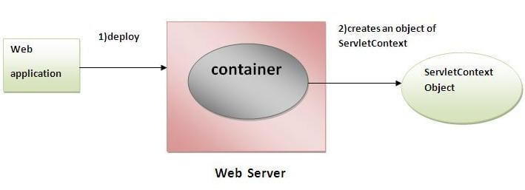

Slide 38
ServletContext
Usage of ServletContext Interface
There can be a lot of usage of ServletContext object. Some of them are as follows:
The object of ServletContext provides an interface between the container and servlet.
The ServletContext object can be used to get configuration information from the web.xml file.
The ServletContext object can be used to set, get or remove attribute from the web.xml file.
The ServletContext object can be used to provide inter-application communication.

Slide 39
web.xml
<web-app>
......
<context-param>
<param-name>parametername</param-name>
<param-value>parametervalue</param-value>
</context-param>
......
</web-app>

Slide 40
ServletContext
There is given some commonly used methods of ServletContext interface.
public String getInitParameter(String name):Returns the parameter value for the specified parameter name.
public Enumeration getInitParameterNames():Returns the names of the context's initialization parameters.
public void setAttribute(String name,Object object):sets the given object in the application scope.
public Object getAttribute(String name):Returns the attribute for the specified name.
public Enumeration getInitParameterNames():Returns the names of the context's initialization parameters as an Enumeration of String objects.
public void removeAttribute(String name):Removes the attribute with the given name from the servlet context.

Slide 41
ServletContext
How to get the object of ServletContext interface
getServletContext() method of ServletConfig interface returns the object of ServletContext.
getServletContext() method of GenericServlet class returns the object of ServletContext.

Slide 42
ServletContext
public class DemoServlet extends HttpServlet{
public void doGet(HttpServletRequest req,HttpServletResponse res)
throws ServletException,IOException
{
res.setContentType("text/html");
PrintWriter pw=res.getWriter();
//creating ServletContext object
ServletContext context=getServletContext();
//Getting the value of the initialization parameter and printing it
String driverName=context.getInitParameter("dname");
pw.println("driver name is="+driverName);
pw.close();
}}

Slide 43
web.xml
<web-app>
<servlet>
<servlet-name>sonoojaiswal</servlet-name>
<servlet-class>DemoServlet</servlet-class>
</servlet>
<context-param>
<param-name>dname</param-name>
<param-value>sun.jdbc.odbc.JdbcOdbcDriver</param-value>
</context-param>
<servlet-mapping>
<servlet-name>sonoojaiswal</servlet-name>
<url-pattern>/context</url-pattern>
</servlet-mapping>
</web-app>

Slide 44
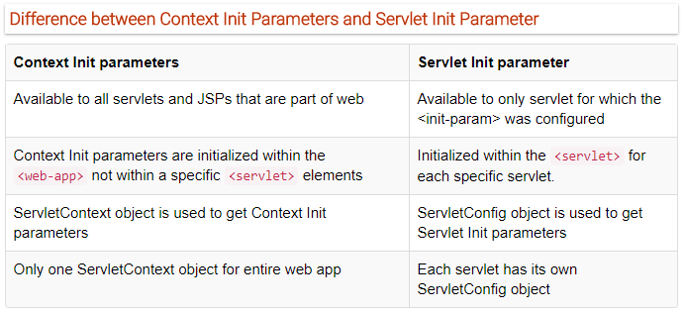

Slide 45
Thank You

